Slide 1
January 15, 2021

Slide 2
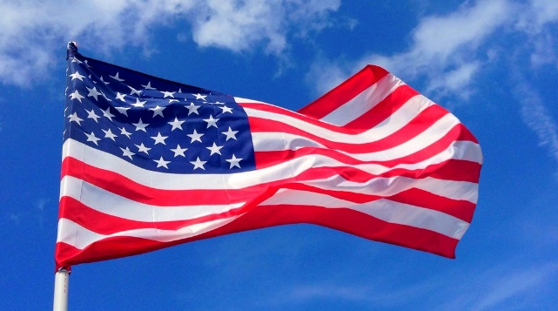
Buying SIR Apparel & Signage
Lee Moy, Asst. Sec.
This Photo by Unknown Author is licensed under CC BY

Slide 3
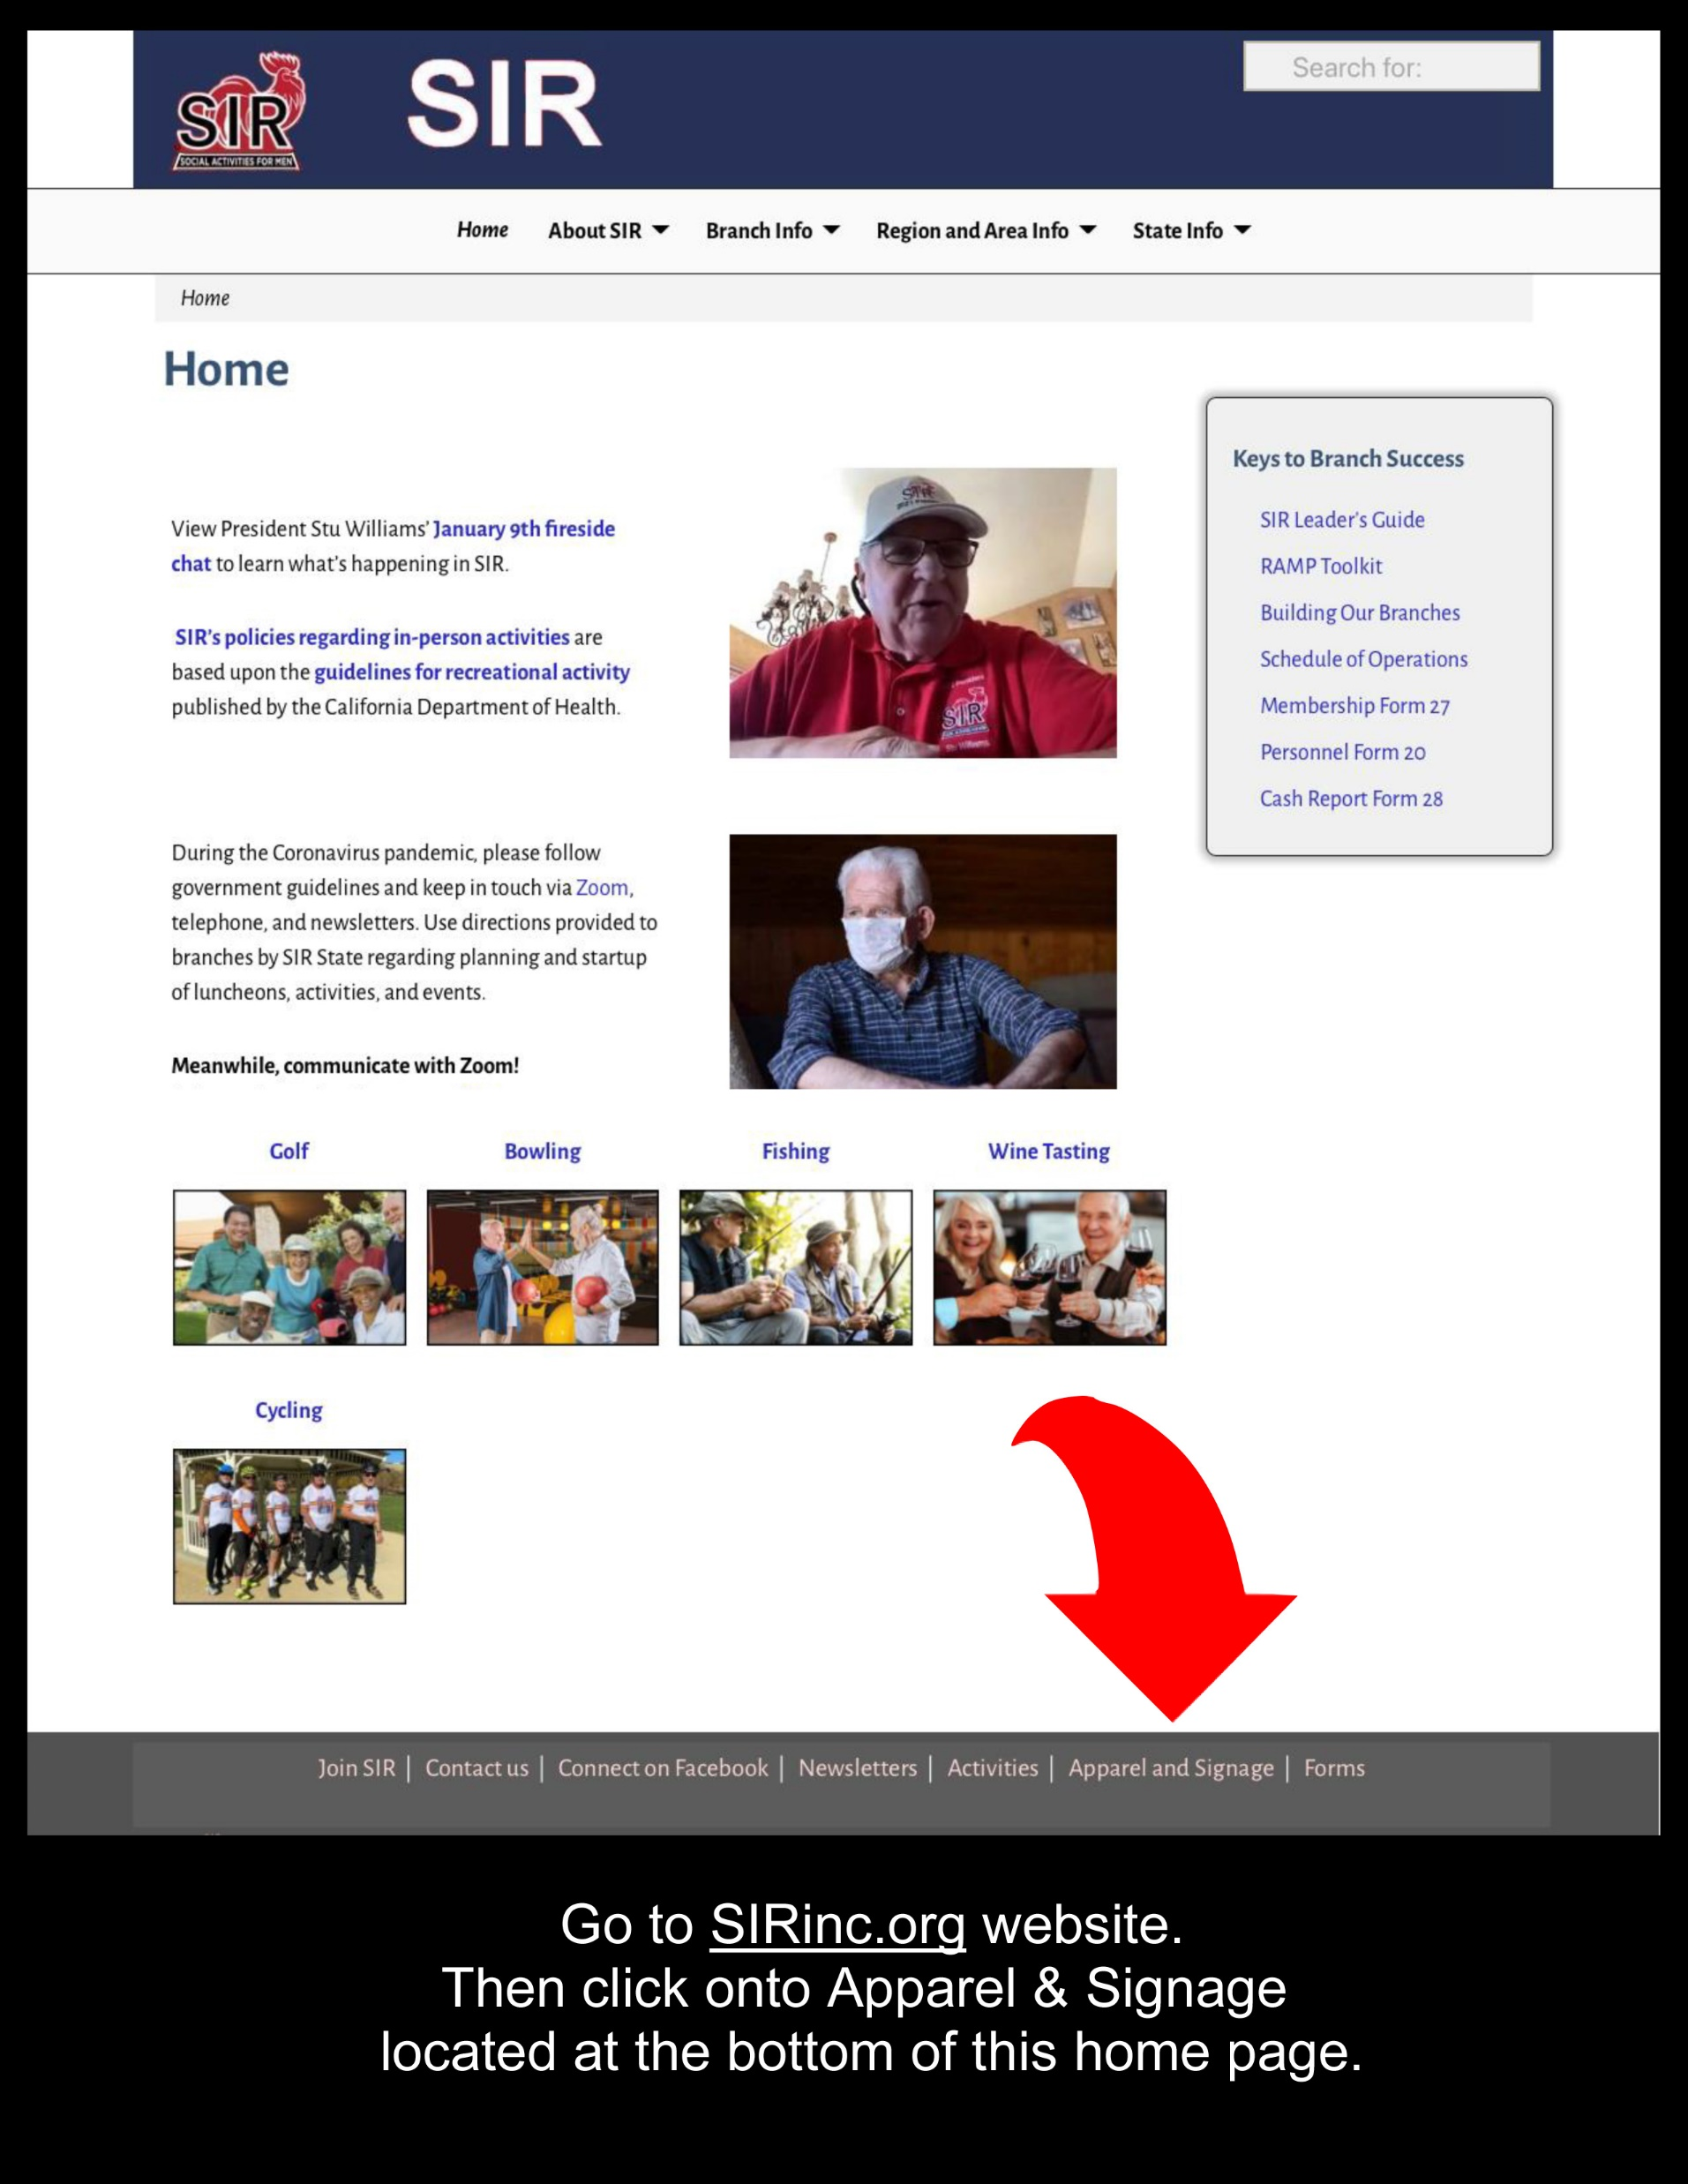

Slide 4
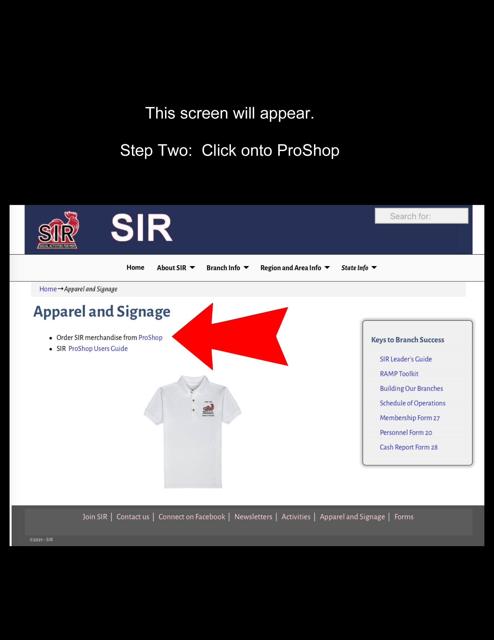

Slide 6
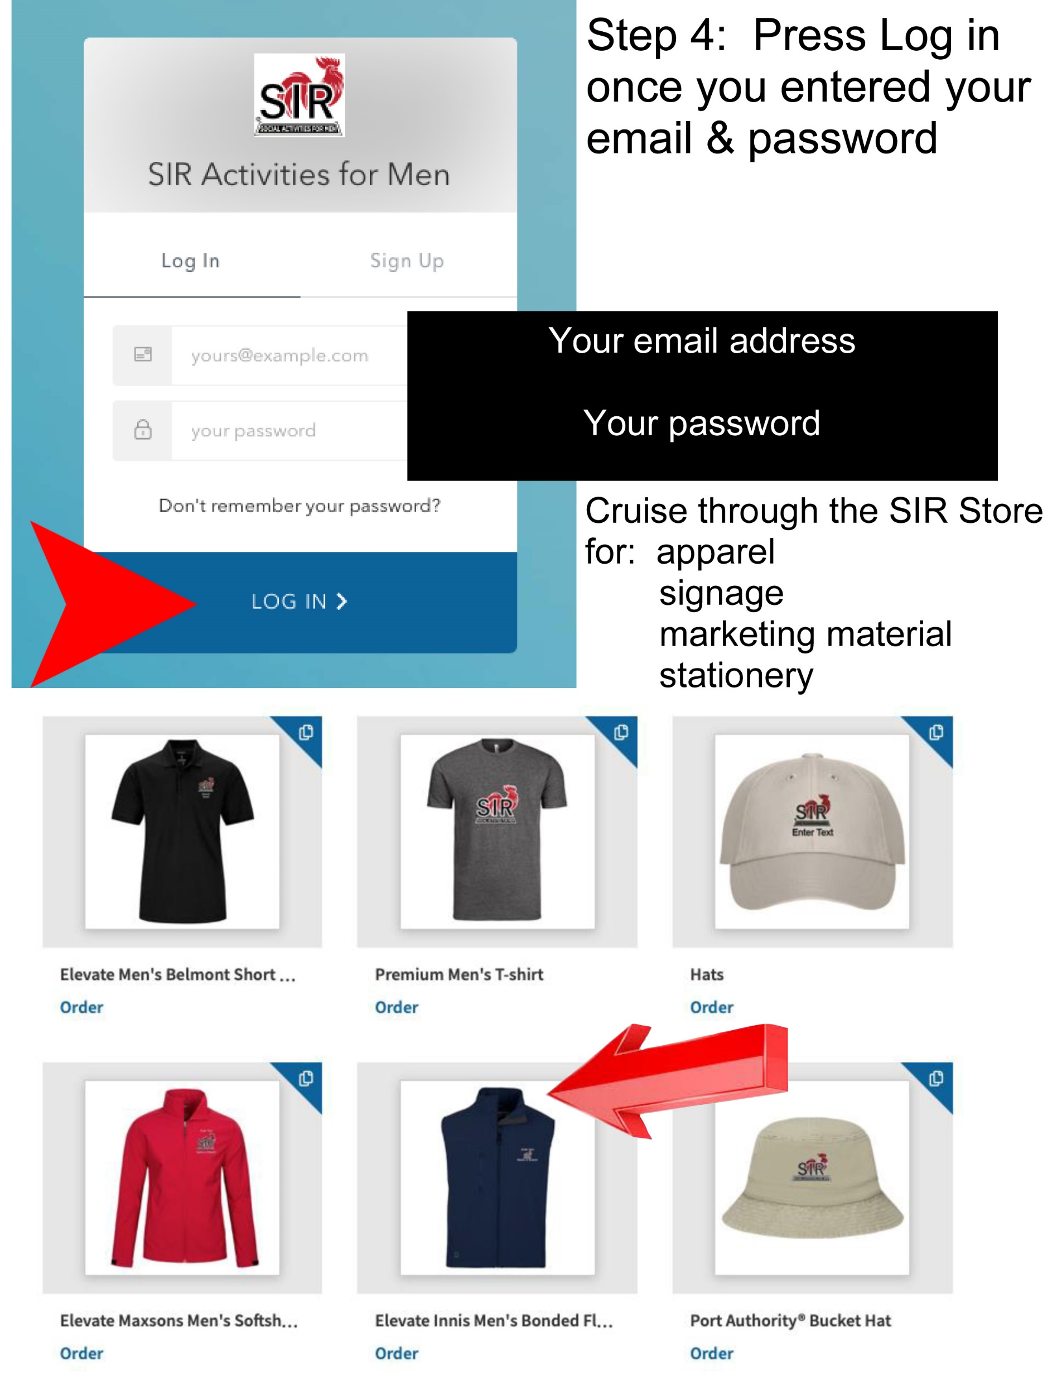

Slide 8
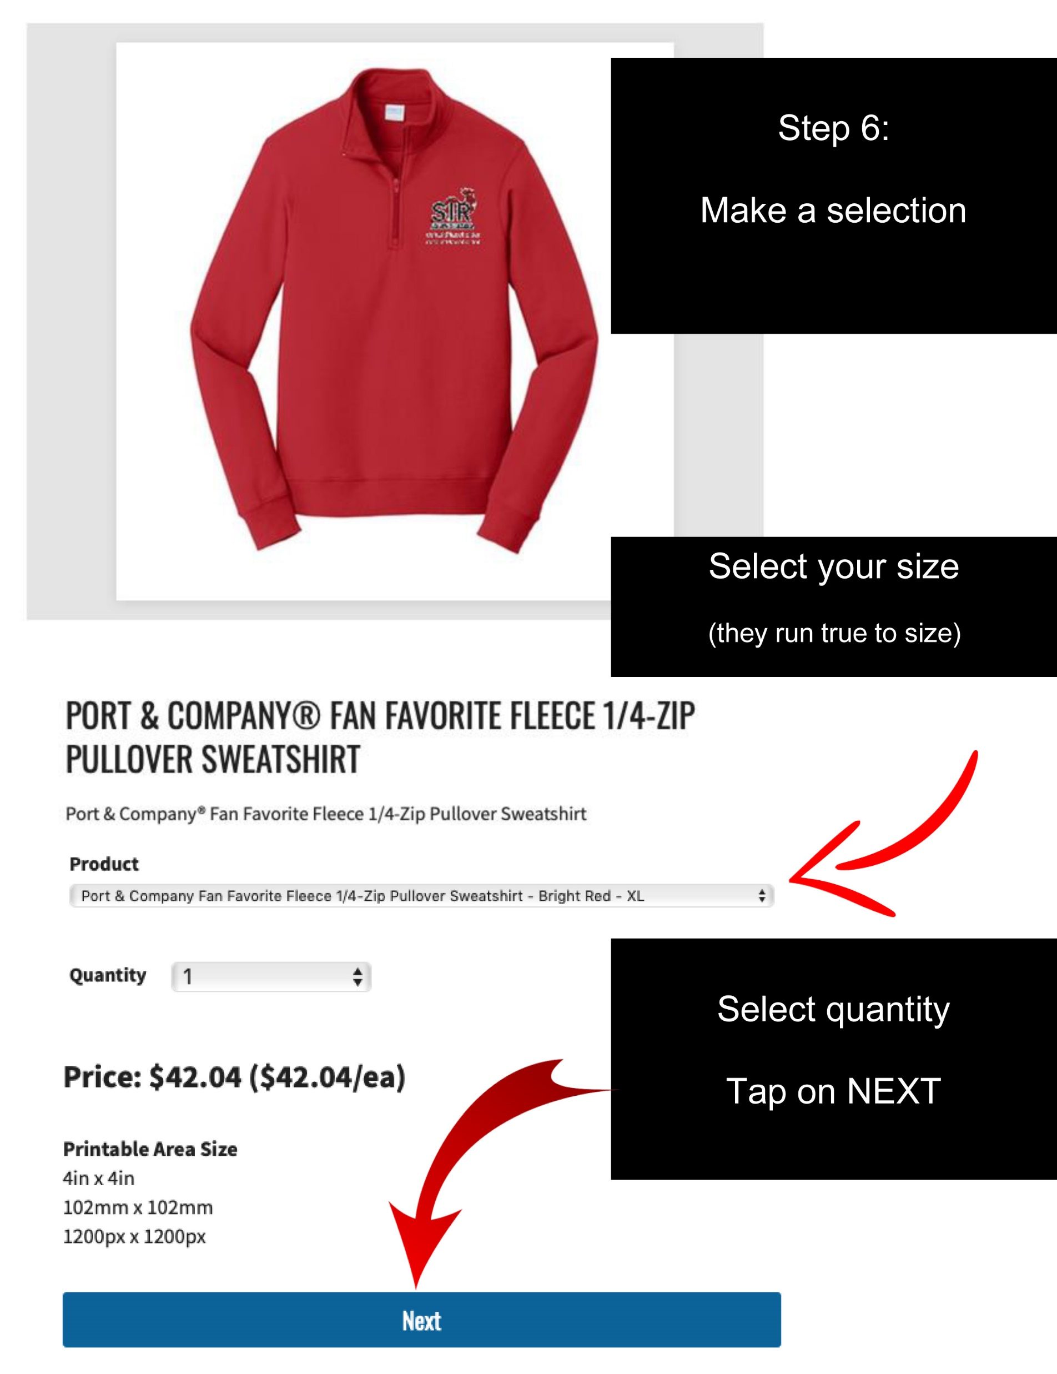

Slide 9
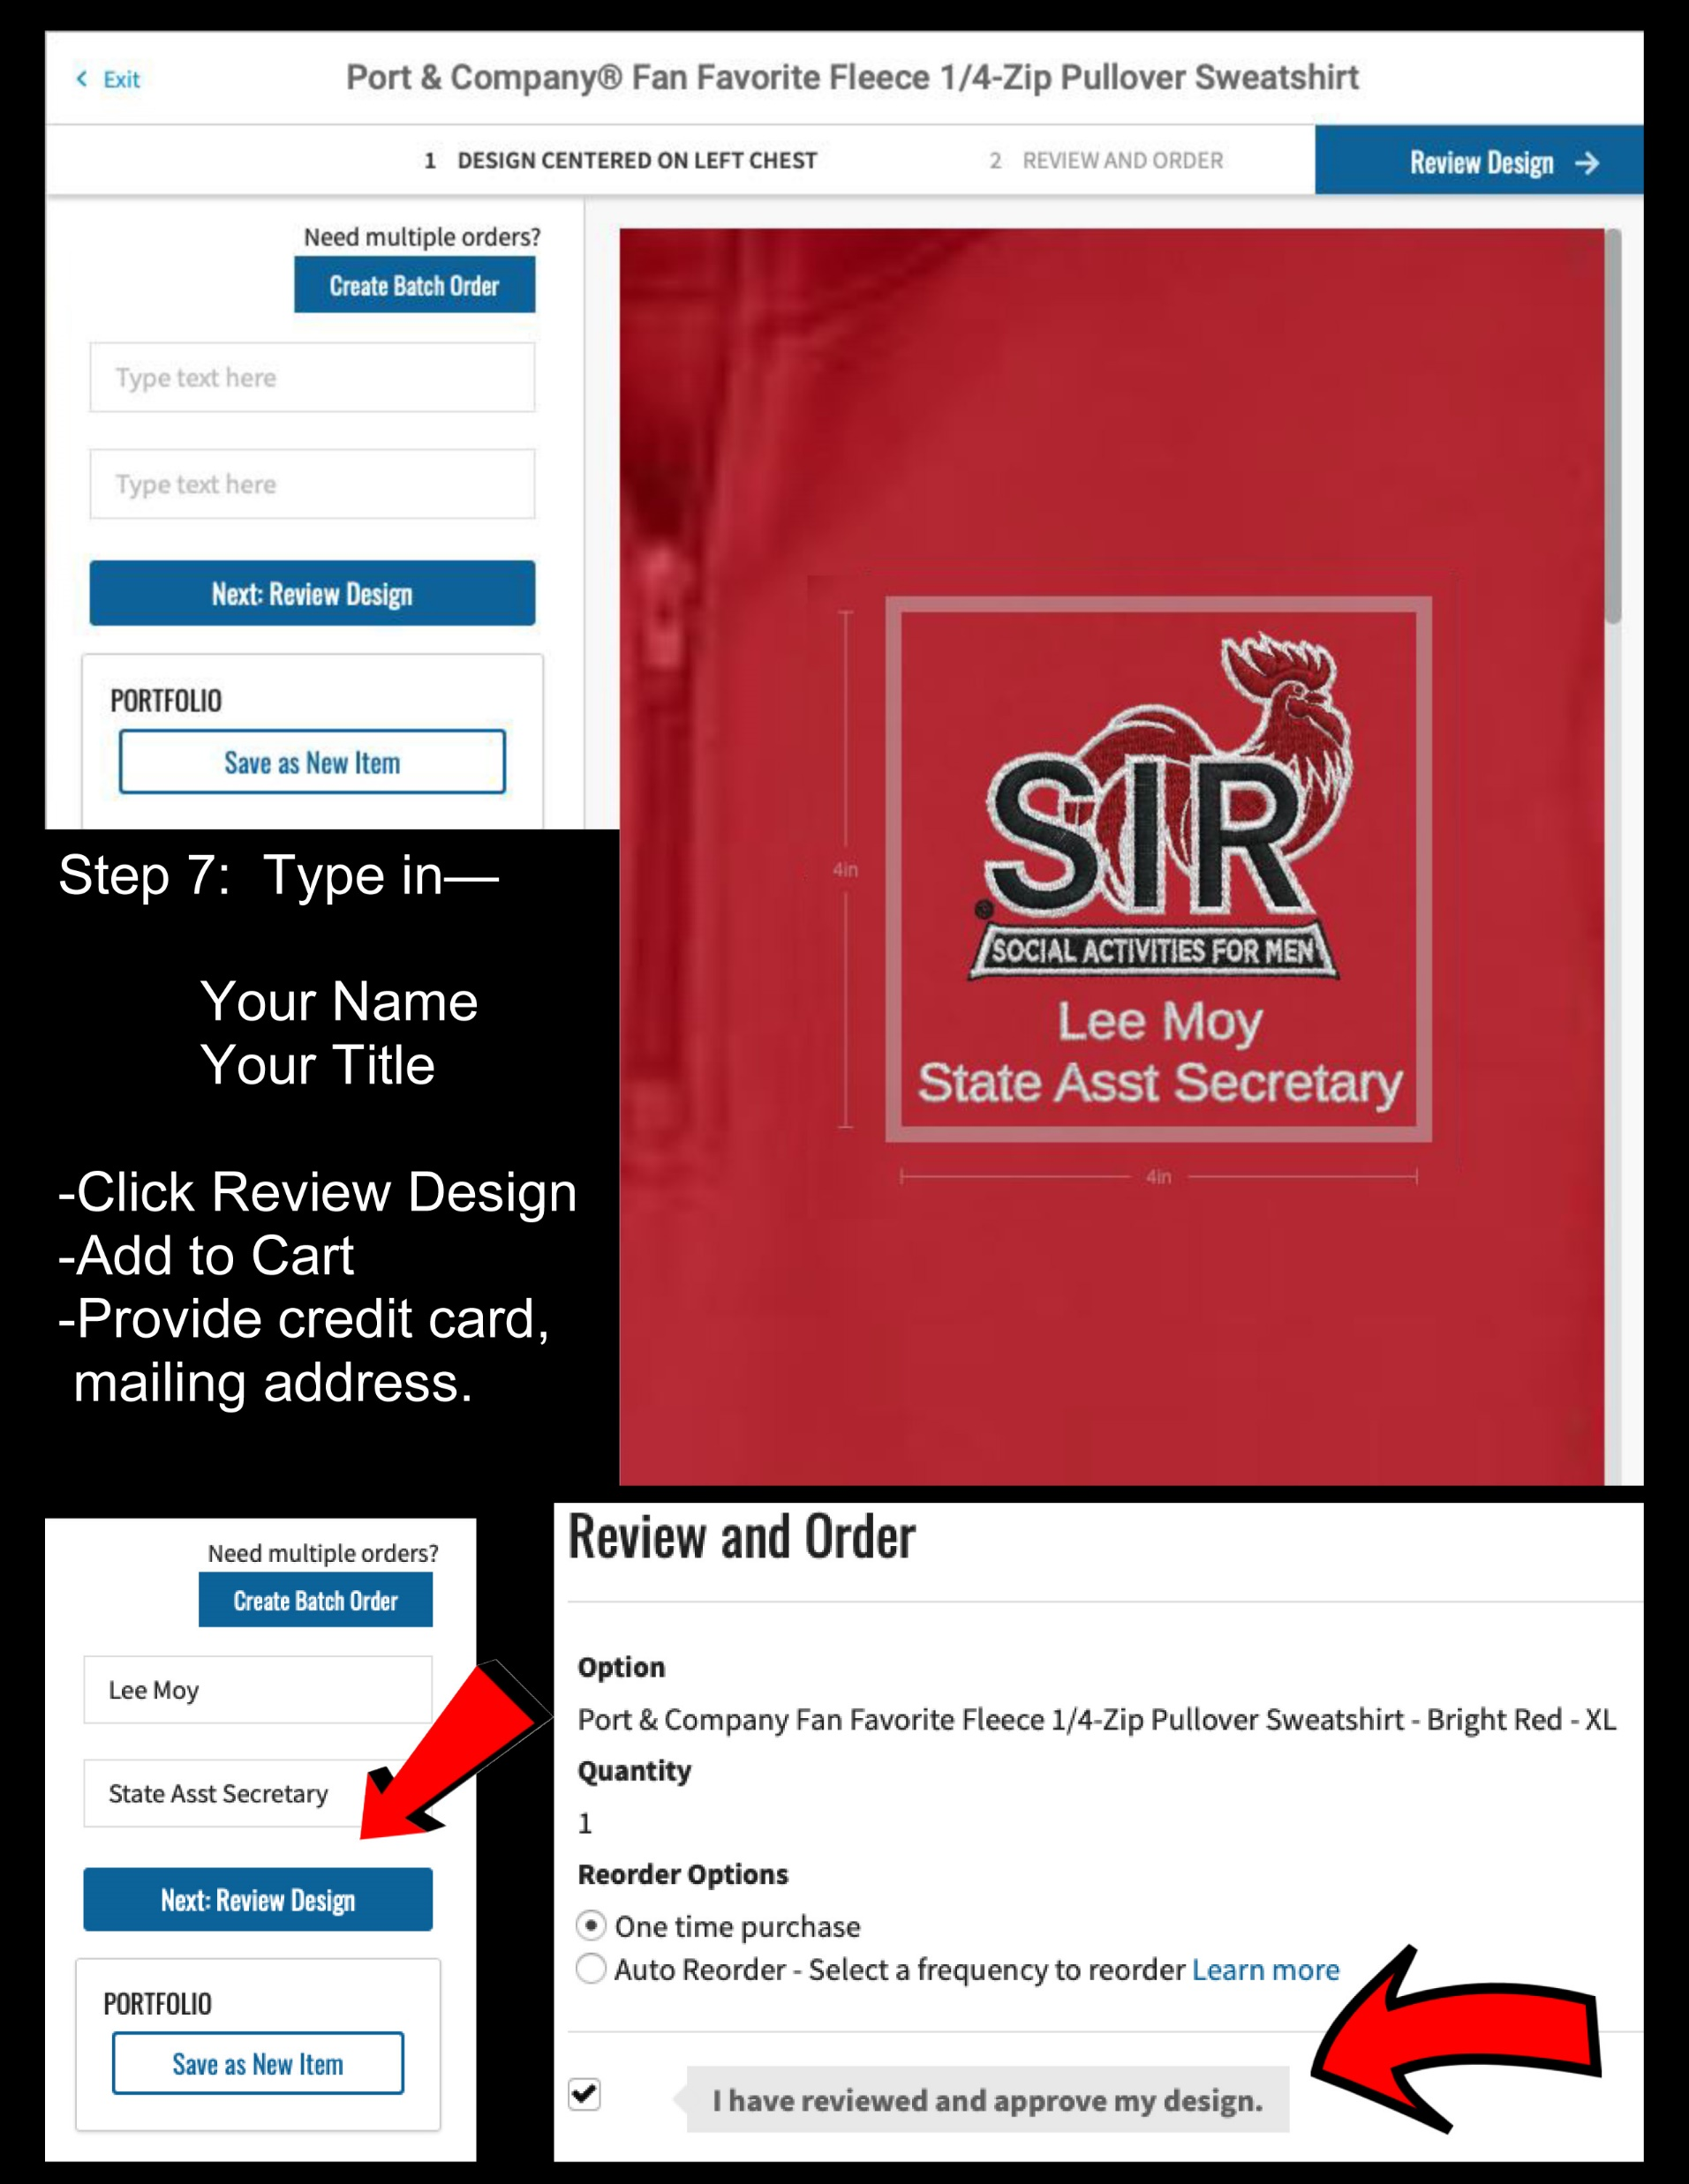

Slide 13
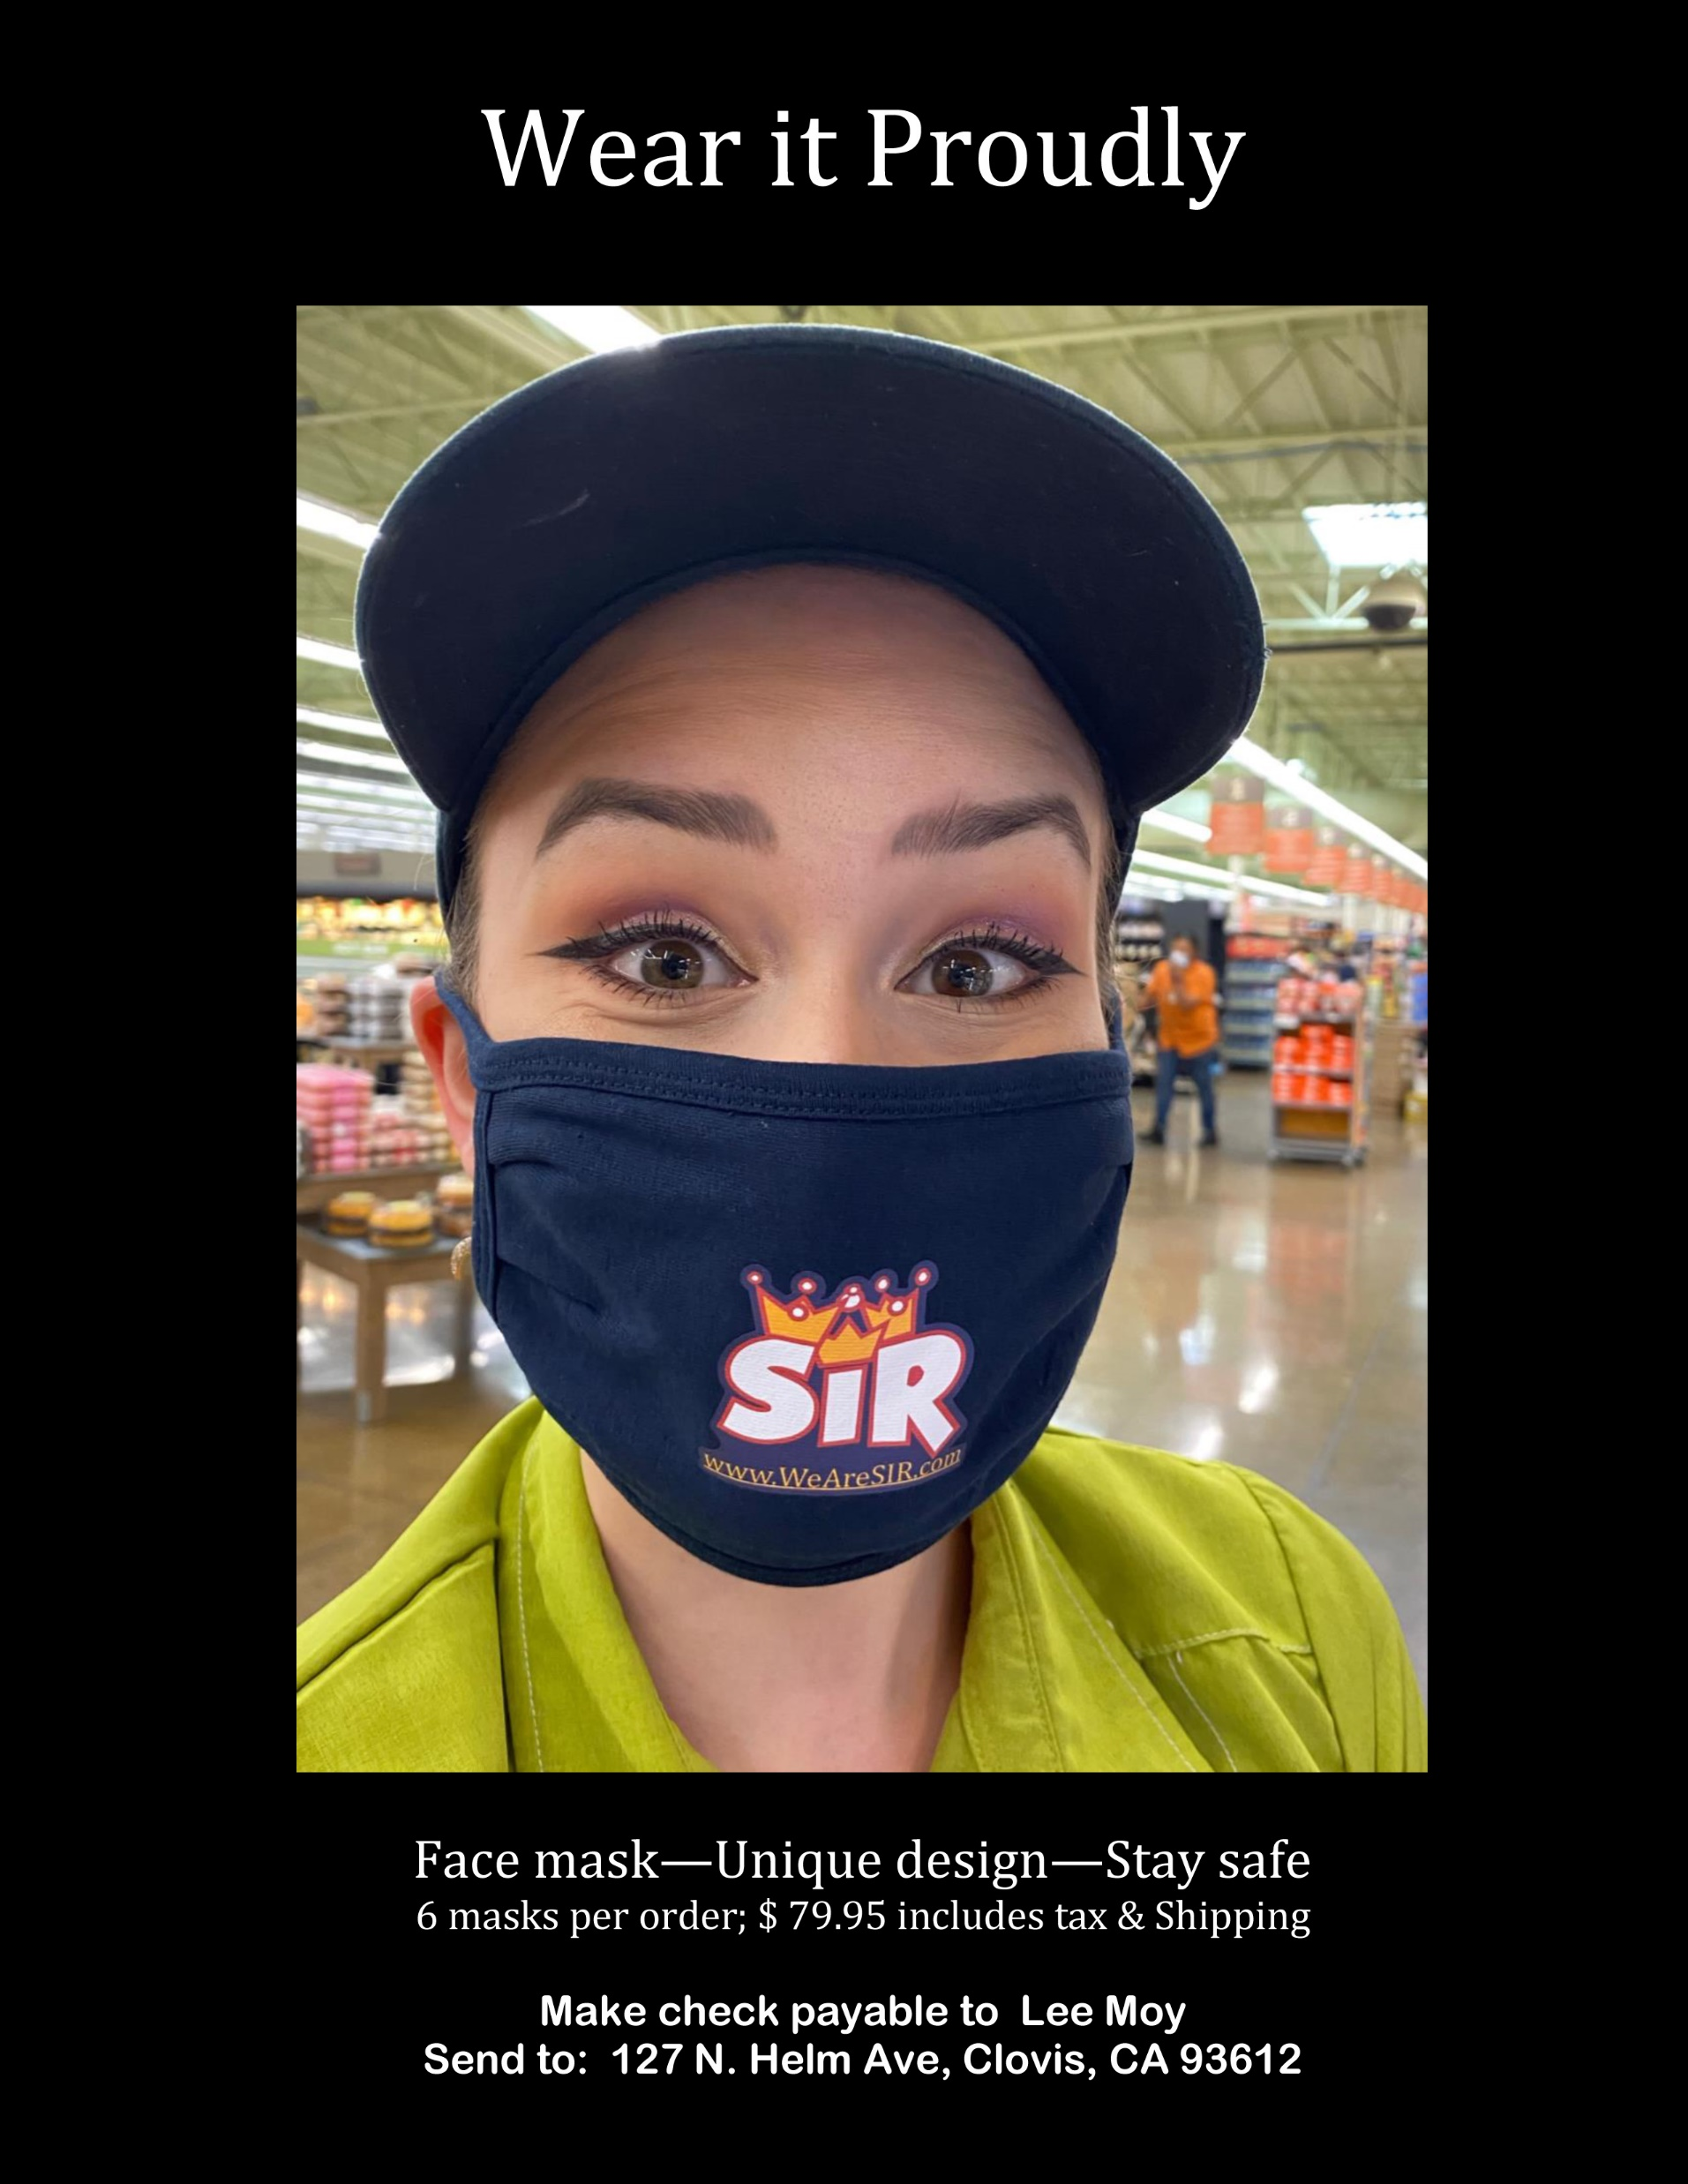

Slide 14
Wrapping the First-Ever Sir Leadership Summit

Slide 17
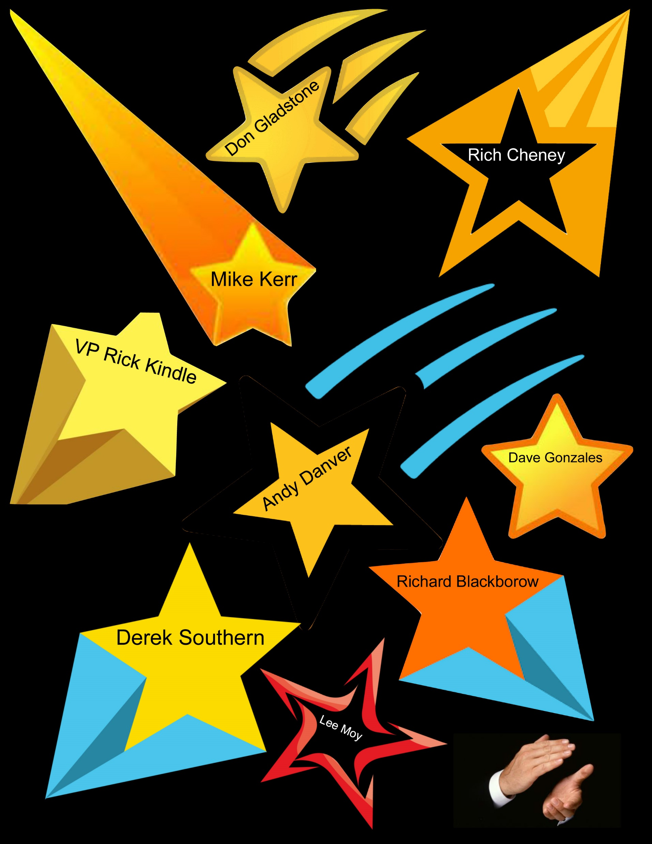

Slide 18
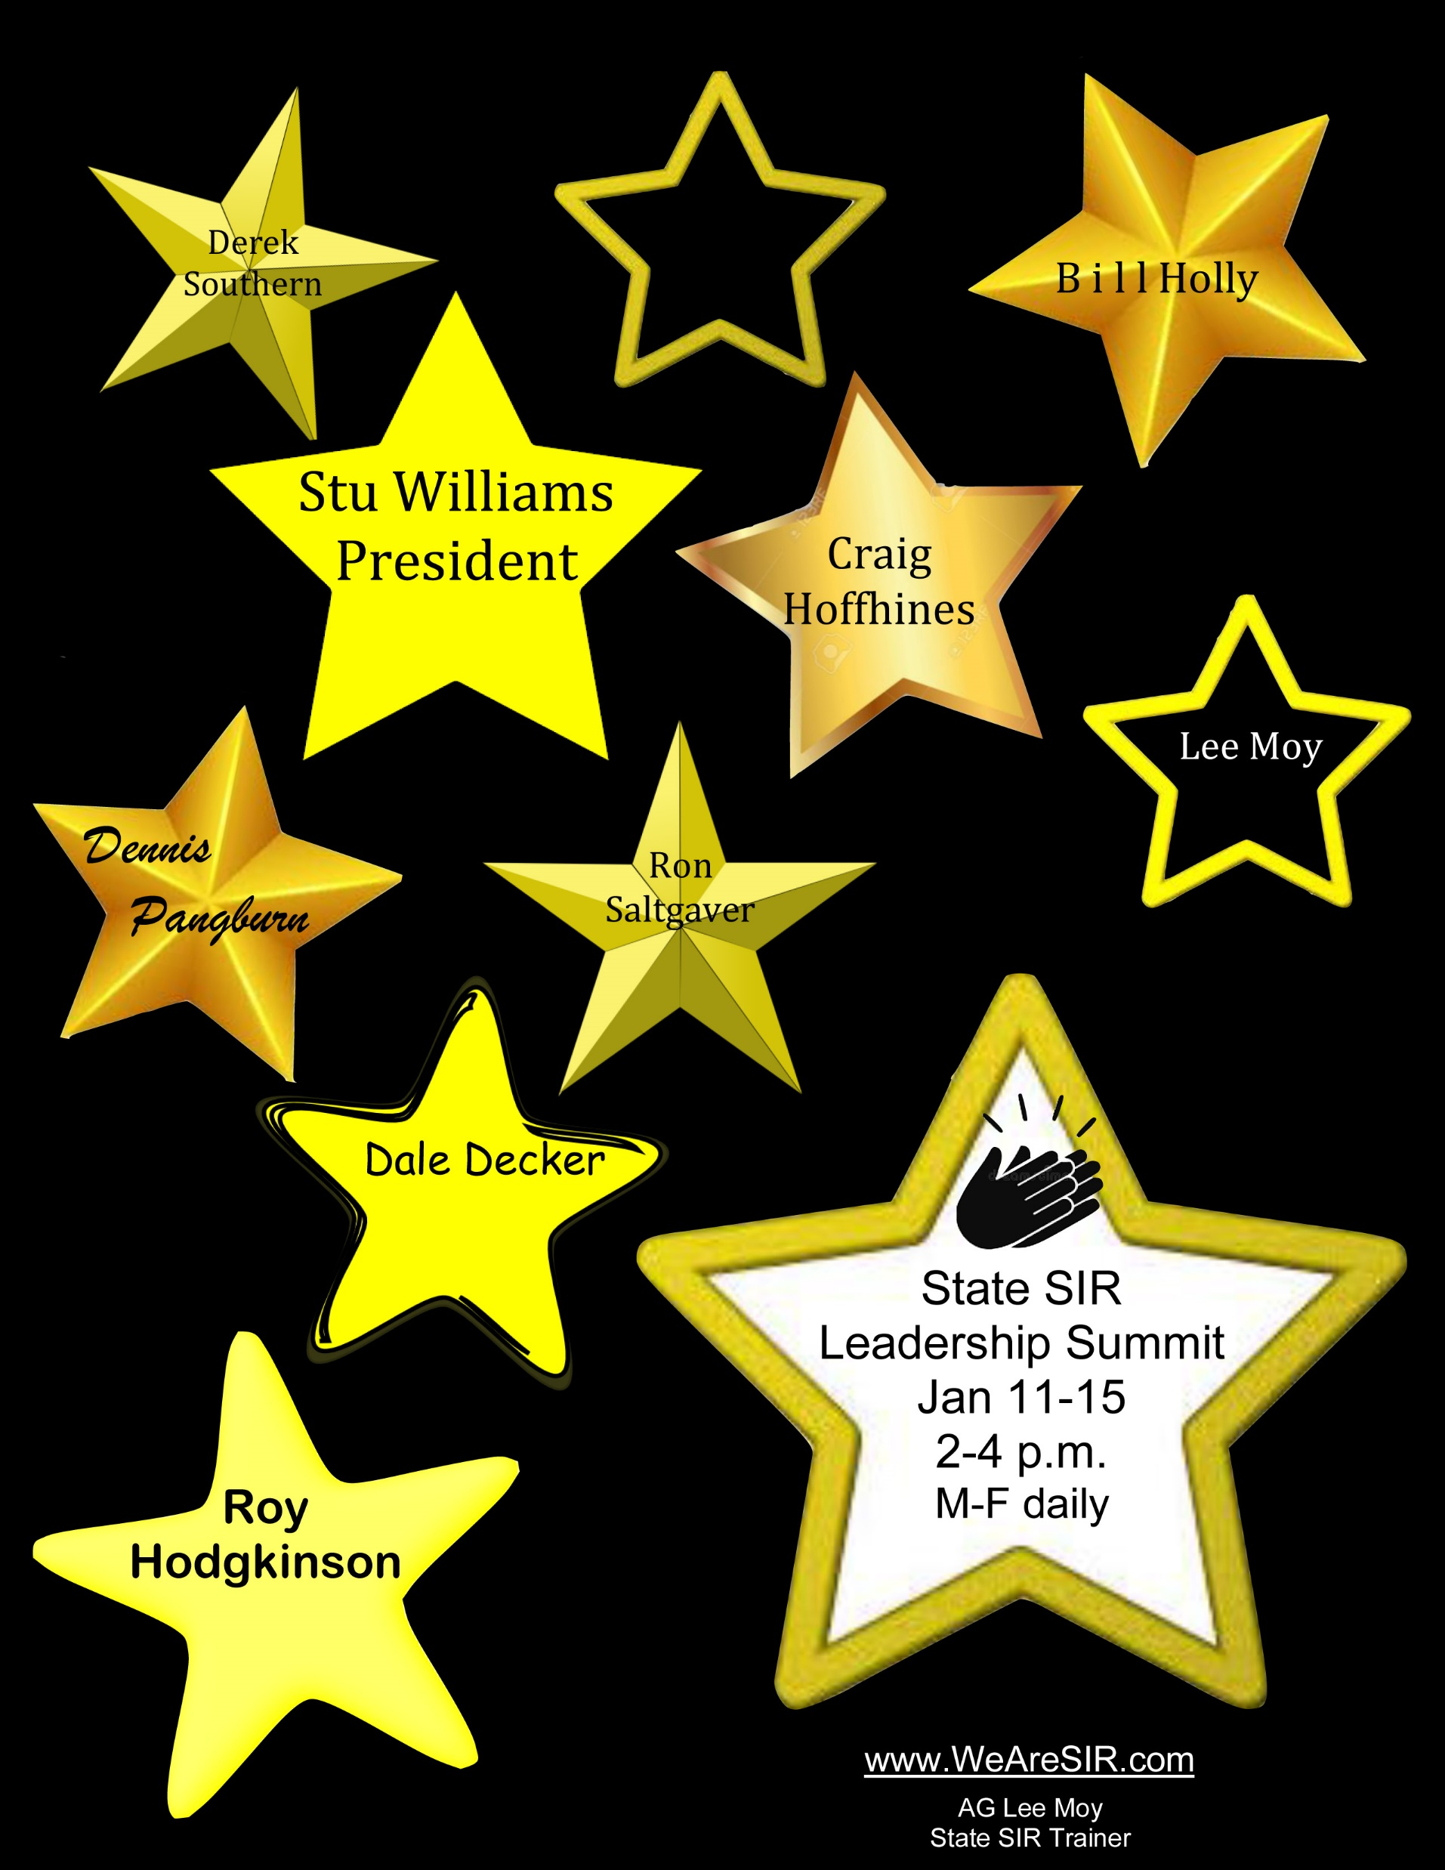

Slide 19
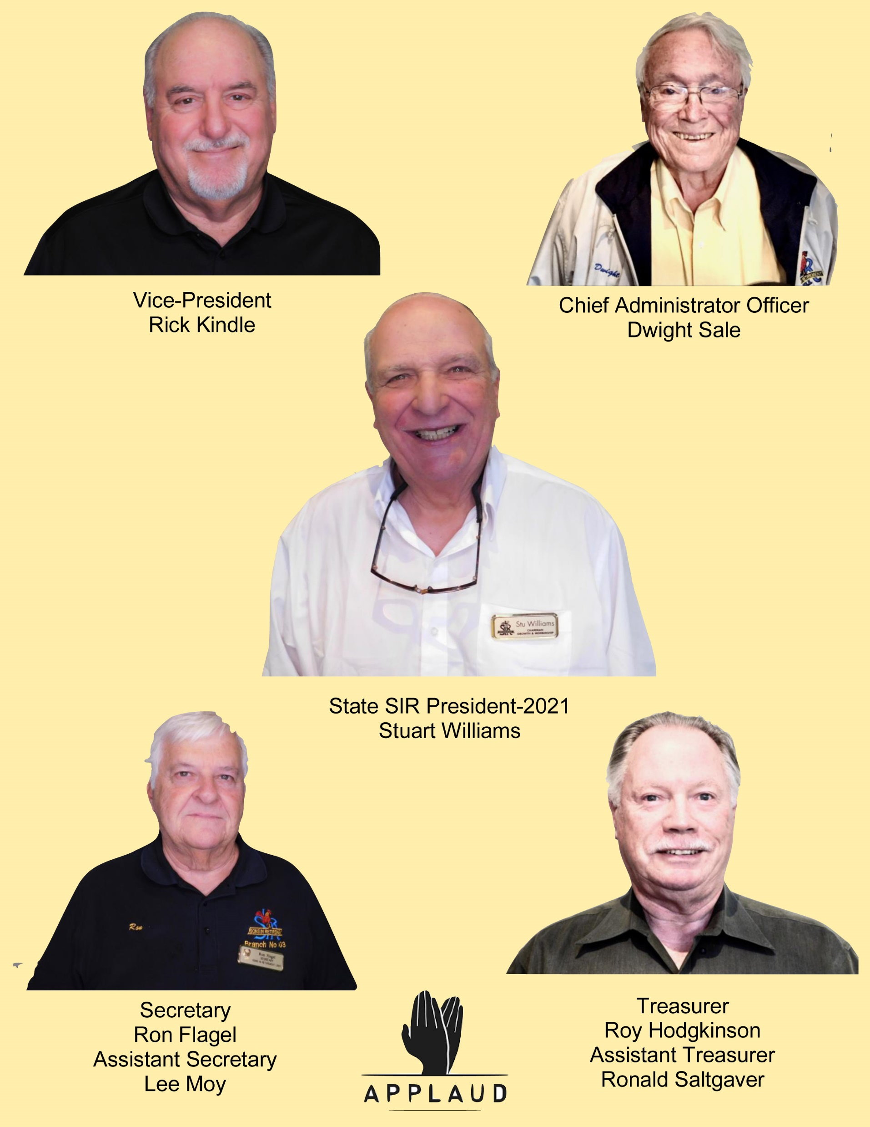

Slide 20
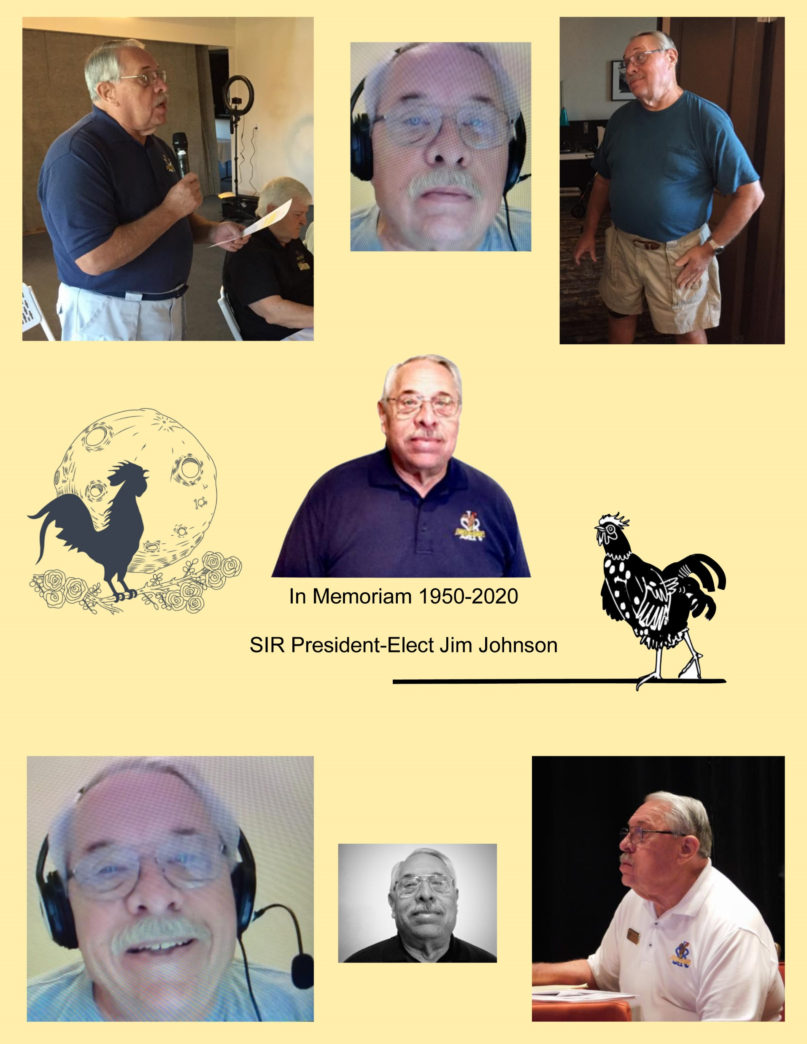

Slide 21
January 15, 2021

